Slide 1
PUSH-UPS
Level 1: Perform push-ups on your knees
Level 2: Straight legged/hands shoulder width apart
Level 3: Straight legged/hands and alternate
Straight legged/hands together
**The closer you get to 90 degrees, the more difficult it becomes**

Slide 2
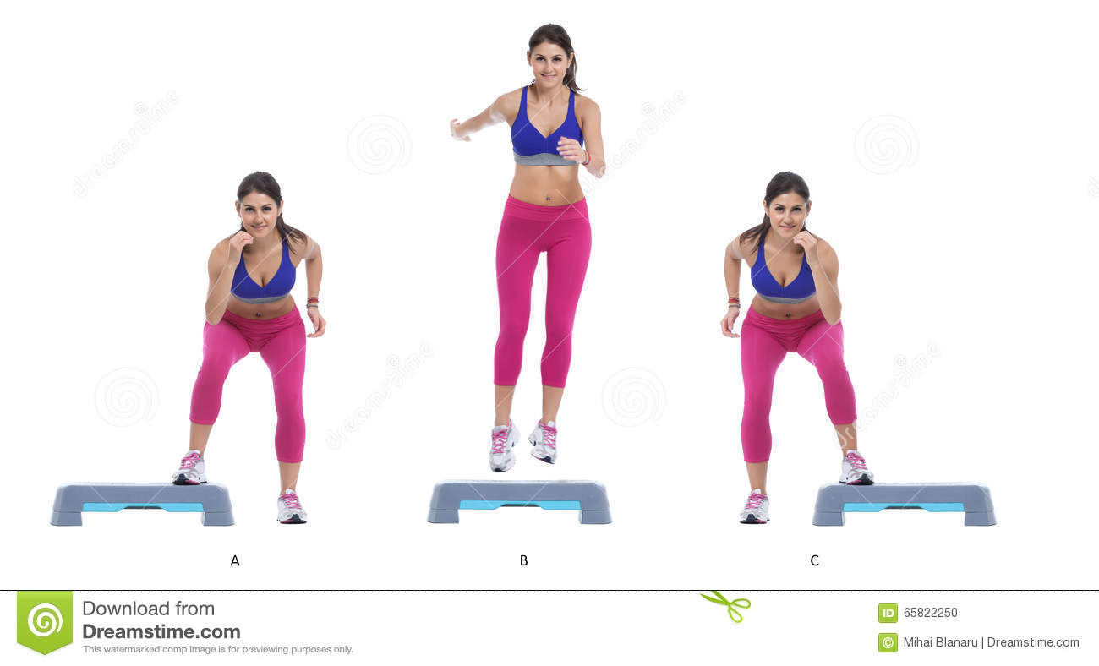
SIDE SKIP
Level 1: Slow Pace
Level 2: Fast Pace

Slide 3
SQUAT JUMPS
Level 1: ½ Squat to jump
Level 2: Full Squat to jump
**Increase the height of jump to
increase difficulty**

Slide 4
LINE HOPS
Level 1: Two foot jump
Level 2: One foot jump
**Increasing speed will increase difficulty**

Slide 5
DELTOID BURNOUTS
Description: Hold band with two hands straight out in front of chest.
Keep elbows locked and extend arms out to side.
Level 1: Red Band
Level 2: Blue Band
Level 3: Green Band
**Moving hands closer together will
increase difficulty**

Slide 6
TERMINATORS
Description: Start in push-up position.
Bring both feet to one side.
Back to starting position.
Bring both feet to the opposite side.
Level 1: High hip push-up position
Step feet to elbow
Level 2: Perfect push-up position
Hop feet to elbow
**To increase difficulty:
Bring knees all the way up to elbow
Hop with feet together

Slide 7
PLANK KICKS
Level 1: High plank position
Level 2: Low plank position
**Bring knee up higher to increase
difficulty

Slide 8
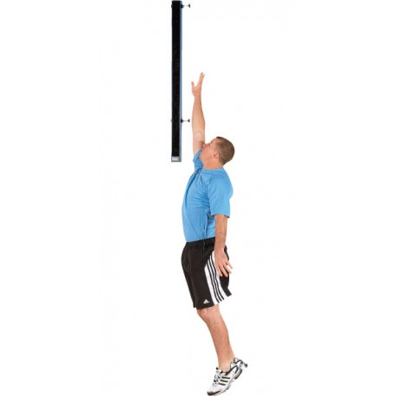
VERTICAL JUMP
MUST JUMP OFF 2 FEET
Level 1: 2-Steps and Jump
Level 2: Stationary Jump

Slide 9
JUMPING LUNGES
Level 1: ½ lunge
Level 2: Full lunge
**Increase jump height to increase
difficulty

Slide 10
BURPEES
Level 1: Step down to crouch
Step up to standing position
No jump
Level 2: Hop down to crouch
Hop up to standing position
with jump up to finish
**Increase speed to increase difficulty

Slide 11
BICEP CURLS
Level 1: Red Band
Level 2: Blue Band
Level 3: Green Band
**Alternate foot position to increase difficulty
- stand with one foot on the band
- stand with two feet on the band
- stand with feet further apart

Slide 12
WALL SIT
Level 1: Sit against wall with legs
at 45 degree angle
Level 2: Sit against wall with legs
at 90 degree angle
**Hold arms straight out or above
head to increase difficulty

Slide 13
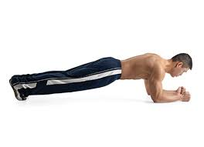
PLANKS
Level 1: High Plank
Level 2: Low Plank
**Straight back increases difficulty

Slide 14
MOUNTAIN CLIMBERS
Level 1: Step foot forward (alternating
foot)
Level 2: Hop foot forward (alternating
foot)
**Lower hip position increases difficulty

Slide 15
JUMPING JACKS
Level 1: Slow pace
Level 2: Fast pace
**Increase speed to increase
difficulty.
Jump on toes to increase
difficulty.

